Slide 1
01
Book Cart Testing
Submitted By:
Laiba Fayyaz (25)
Sundas Iqbal (31)
Afifa Rafiq (61)
Areesha Qamer (75)
Submitted To:
Mr. Faisal Hafeez
Department:
Information Technology 5th A Morning

Slide 2
02
Introduction
Project Title:
Software Testing of BookCart Web Application
System:
BookCart – Online Book Store
https://bookcart.azurewebsites.net/
System Type:
Web-based E-Commerce Application

Slide 3
03
Purpose & Users
Purpose:
    Browse and search books
    User registration and login
    Cart and order management
    Admin book management
Users:
    Customers
    Admins

Slide 4
04
Major Functional Modules
Module | Description
User Management | Register, Login, Logout
Book Module | View & Search Books
Cart Module | Add / Remove Books
Order Module | Place & View Orders
Admin Module | Manage Books
APIs | Backend Services

Slide 5
05
Testing Scope & Tools
Testing Types
        Manual Testing
        Automation Testing
        API Testing
Tool | Purpose
Selenium | Automation
Postman | API Testing
Jira | Bug Tracking

Slide 6
Manual Testing Overview
Objective
Verify system functionality manually based on requirements.
Coverage
        Functional testing
        Negative testing
        UI responsiveness testing
06

Slide 7
Manual Testing Results
Total Test Cases
25 Manual Test Cases
07
Status | Count
Pass | 16
Fail | 09
Total | 25
Key Issues
Books not displayed
Add to cart failure
Missing login error message
Mobile UI responsiveness issue

Slide 8
08
Sample Manual Test Cases
Scenario | Status
Open Homepage | Pass
Login with valid data | Pass
Add book to cart | Fail
UI Responsiveness | Fail

Slide 9
Automation Testing Overview
Purpose
    Automate critical user flows
    Reduce manual effort
    Improve test repeatability
Tool Stack:
09
Tool | Usage
Python | Automation scripting
Selenium | Browser automation
Jira | Bugs

Slide 10
10
Automation Test Results
Test Case | Result
Homepage Load | Fail
Register | Pass
Login | Pass
Search Books | Fail
Add to Cart | Fail
Cart Page | Pass
Book Details | Fail
Logout | Pass

Slide 11
API Testing Overview
API Testing using Postman
    Tool Used: Postman
    Application: BookCart
    Total APIs Tested: 7
    APIs tested: Registration, Login, Profile, Dashboard, Delete Book
    Methods used: GET, POST, PUT, DELETE
11
API | Method | Status
Register | POST | Fail
Login | POST | Fail
Profile | GET | Pass
Admin Dashboard | GET | Pass
Delete Book | DELETE | Fail

Slide 12
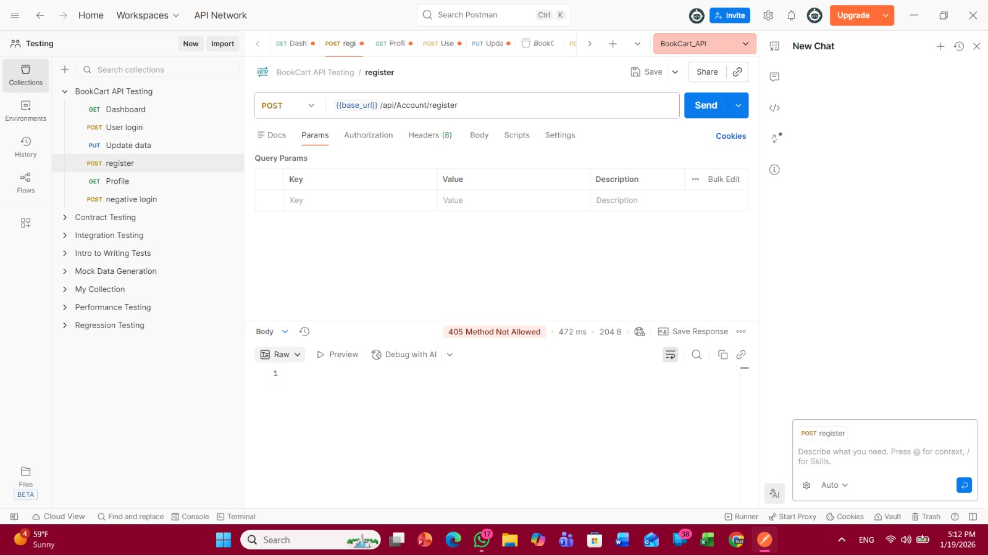
Postman Demo
Title:
Postman API Execution Demo
POST request returning 405
12

Slide 13
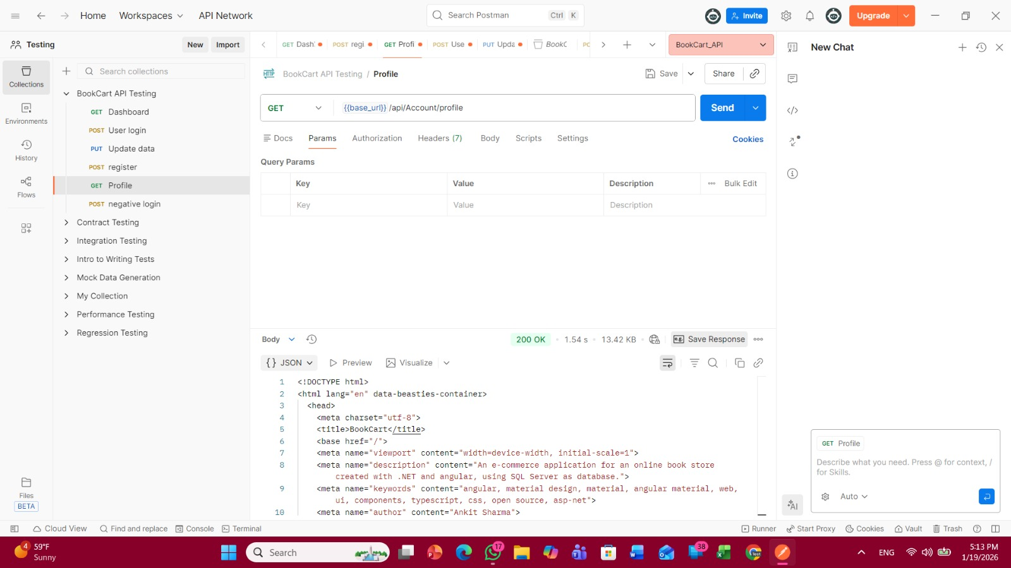
13
GET request returning 200

Slide 14
14
Results:
Executed API requests using Postman
Observed 405 Method Not Allowed for POST/PUT/DELETE
Successful responses for GET APIs

Slide 15
15
Bug Reporting & Documentation
Bug Reporting
      Tool: Jira
      Defects Logged: 5–7
      Standard defect format used
QA Documents
      Test Plan
      Manual Test Cases
      Automation Scripts
      Postman Collection
      Test & Defect Summary Reports

Slide 16
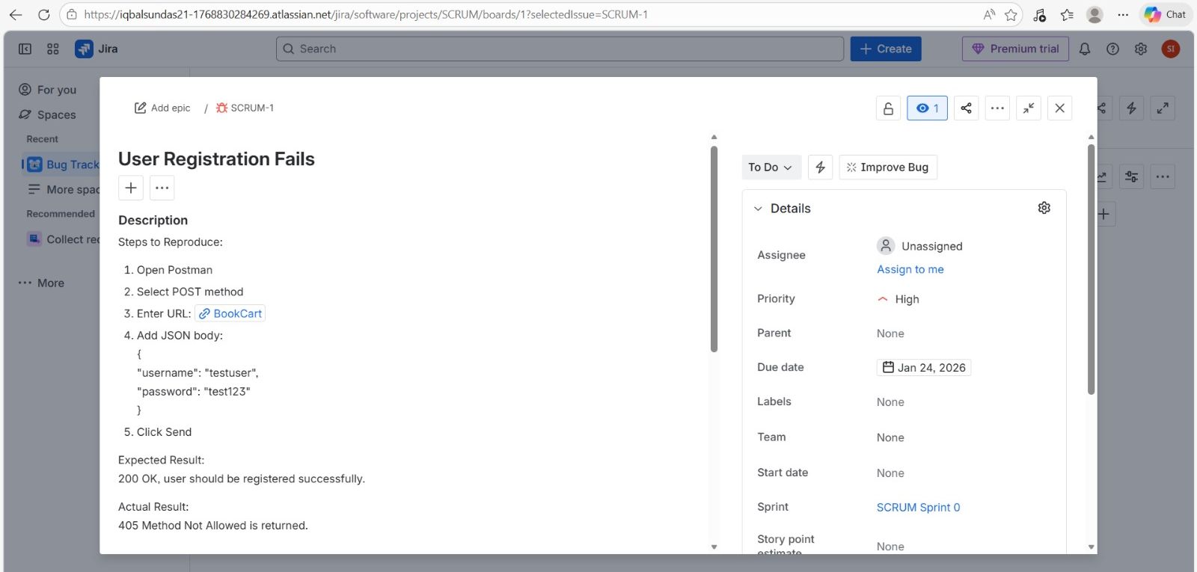
Defect Logging
Title:
Defect Reporting from API Testing
Content:
API failures logged in Jira
16

Slide 17
17
Final Conclusion
        Manual, Automation & API testing completed
        Multiple functional and API defects identified
        Automation reduced testing effort
        Proper QA documentation ensured traceability and quality

Slide 18
18
Thankyou!

